Slide 1




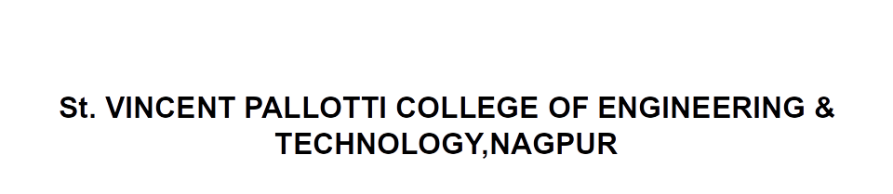
Open Elective –III Transportation System
CV705T

Slide 2

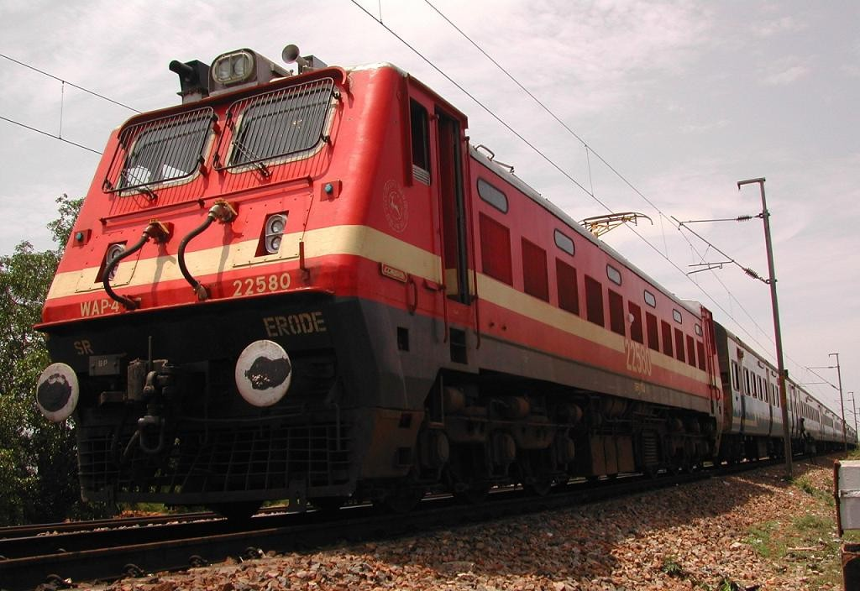

Slide 3
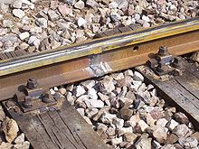

Sleepers
A railway sleeper is a rectangular object used as a base for railroad tracks. Ties are members generally laid transverse to the rails, on which the rails are supported and fixed, to transfer the loads from rails to the ballast and subgrade, and to hold the rails to the correct gauge.
Types of Sleepers:
Steel Sleepers
Wooden Sleepers
Concrete Sleepers

Slide 4
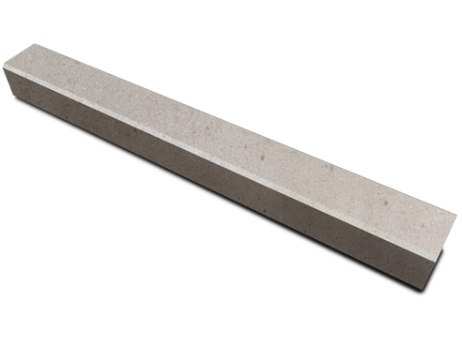
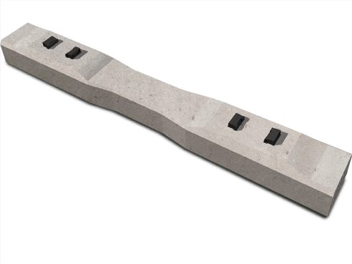
Sleepers
Pre-Stressed Concrete Sleepers
A concrete sleeper is a railroad tie made out of steel reinforced concrete.

Slide 5
Railway Sleepers
Depending upon the position in a railway track, sleepers may be classified as:
These are the early form of sleepers which are not commonly used nowadays
Longitudinal Sleepers: It consists of slabs of stones or pieces of woods placed parallel to and underneath the rails. To maintain correct gauge of the track, cross pieces are provided at regular intervals.

Slide 6
At present this type of sleepers are discarded mainly because of the following reasons.
Running of the train is not smooth when this type of sleepers is used.
Noise created by the track is considerable.
Cost is high.
Transverse Sleepers: Transverse sleepers introduced in 1835 and since then they are universally used.
Timber/wooden sleepers
Steel sleepers
Cast Iron Sleepers
Concrete Sleepers

Slide 7
Timber Sleepers
The timber sleepers nearly fulfilled all the requirements of ideal sleepers and hence they are universally used. The wood used may be like teak, sal etc or it may be coniferous like pine.
The salient features of timber/wooden sleepers with advantages and disadvantages.

Slide 8
Advantages of Timber Sleepers
They are much useful for heavy loads and high speeds
They have long life of 10-12 years depending upon the climate, condition, rain, intensity, nature of traffic, quality of wood etc
Good insulators and hence good for track circuited railway tracks
They are able to accommodate any gauge
Suitable for salty regions and coastal areas
Can be used with any section of rail
Can be handled and placed easily
They are not badly damaged in case of derailment
They are not corroded
Cheaper than any other types of sleepers

Slide 9
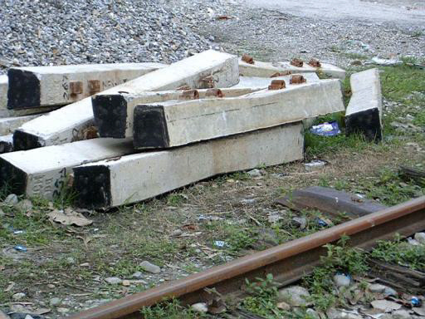
Disadvantages of Timber Sleepers
Liable to be attacked by vermin so, they must be properly treated before use
Liable to catch fire
They do not resist creep
They are affected by dry and wet rot
Become expensive day by day
Life is shorter compare to others

Slide 10
Steel sleepers
They are in the form of steel trough inverted on which rails are fixed directly by keys or nuts and bolts and used along sufficient length of tracks.
Advantages of Steel Sleepers
Have a useful life of 20-25 years.
Free from decay and are not attacked by vermins
Connection between rail and sleeper is stronger

Slide 11
Connection between rail and sleeper is simple
More attention is not required after laying
Having better lateral rigidity
Good scrap value
Suitable for high speeds and load
Easy to handle
Good resistance against creep

Slide 12
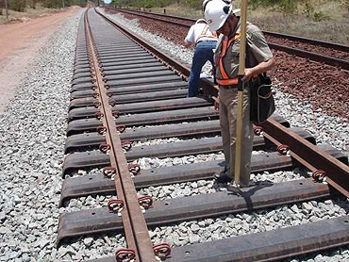
Disadvantages of Steel sleepers
Liable to corrosion by moisture and should not because in salty regions
Good insulators and hence cannot be used in track circuited regions
Cannot be used for all sections of rails and gauges
Should not be laid with any other types of ballast except store

Slide 13
Very costly
Can badly damaged under derailments
Way gauge is obtained if the keys are over driven
The rail seat is weaker
Having good shock absorber as there is not cushion between rail foot and ballast

Slide 14
Cast Iron Sleepers
They consist of two pots or plates with rib and connected by wrought iron tie bar of section of about 2" ½" each pot or plate is placed below each rail. The pot is oval in shape with larger diameter 2'-0" and smaller diameter 1'-8" is preferred.
Plate sleepers consist of rectangular plates of size about 2' – 10' x 1' – 0".
The relative advantages and disadvantages are given below.
Advantages of Cast Iron Sleepers
Long life upto 50-60 years- High scrape value as they can be remolded
Can be manufactured locally - Provided sufficient bearing area
Much stronger at the rail seat - Prevent and check creep of rail
They are not attacked by vermin

Slide 15
Disadvantages Cast Iron Sleepers
They are prone to corrosion and cannot be used in salty formations and coastal areas - Not suitable for track circuited portions of railways
Can badly damage under derailment
Difficult to maintain the gauge as the two pots are independent
Require a large number of fastening materials - Difficult to handle and may be easily damaged - Lack of good shock absorber - They are expensive

Slide 16
Concrete sleepers
R.C.C and pre-stressed concrete sleepers are now replacing all other types of sleepers except to some special circumstances such as crossing bridges etc here timber sleepers are used.
They were first of all used in France round about in 1914 but are common since 1950. They may be a twin block sleepers joined by an angle iron. It may be a single block pre-stressed type.

Slide 17
Advantages Concrete Sleepers
Durable with life range from 40-50 years
They can be produced on large quantities locally by installing a plant
Heavier than all other types thus giving better lateral stability to the track
Good insulators and thus suitable for use in track circuited lines
Efficient in controlling creep - They are not attacked by corrosion

Slide 18
Free from attacks of vermin and decay, suitable for all types of soils
Most suitable for welded tracks- Prevent buckling more efficiently
Initial cost is high but proves to be economical in long run
Effectively and strongly hold the track to gauge
Inflammable and fire resistant

Slide 19
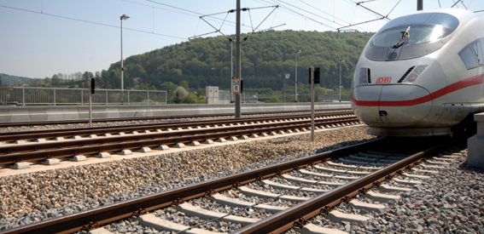
Disadvantages Concrete Sleepers
Difficult to be handled
Difficult to be manufactured in different sizes thus cannot be used in bridges and crossing
Can be damaged easily while loading and unloading

Slide 20


